Slide 1
A Simple Guide to Biotechnology and Machine Learning Modelling cell receptor and drug interaction
Student: Gintaras Koncevicius ID: U1334444
Programme: Software Engineering Course Number: CN6103
Project Supervisor: Ray Ruocco

Slide 2
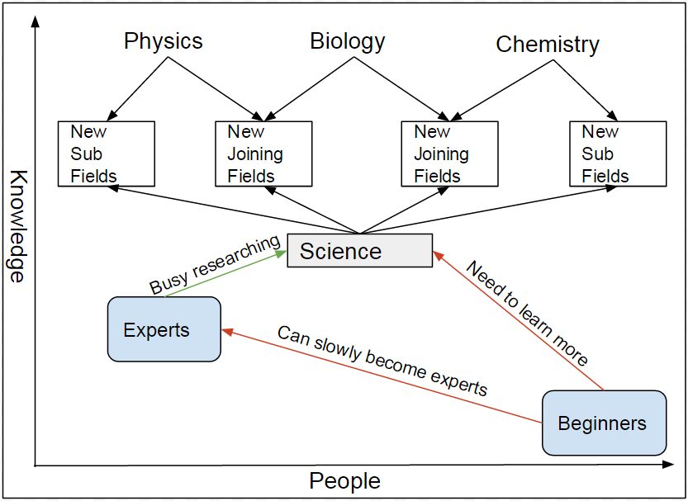
Problem addressed: the knowledge gap between experts and beginners.
Advancing science creates new fields.
Each field needs experts.
Experts doing research is more valuable.
Knowledge gaps increase.
Resources required to teach raise.

Slide 3
Aim to educate about how Machine Learning could be used in Biotechnology.
To review machine learning in bioinformatics.
To find and explain one of the best techniques.
To implement it using object oriented programming.
To compare it with existing implementations.
To evaluate the results and offer ideas on improvements.

Slide 4
Background Research
After reviewing several papers it became clearer that SVM will be chosen for implementation.
Ashtawy et al. (2012) compared different machine learning techniques ranging from clustering K-Nearest Neighbour to regression, decision trees and SVM, which had best results.
“Support vector machine learning algorithm has been extensively applied within the field of computational biology” (W. Noble, 2003, p1).
”From all these studies it is evident that among all the prediction methods, SVM performs better (A. Chinnasamy et al., 2003, p3).
SVM can be used” to learn to differentiate true from false positives” (W. Noble, 2003, p23).

Slide 5
Problems Encountered
Size of the problem made it difficult to solve it.
Size of the topic made it difficult to describe it.
Implementing SVM with OO was not as easy as expected.
Different supervisors having different requirements made it difficult to connect all ideas.
Unclear how to evaluate the project.

Slide 6
Solutions
Size of the problem and topic was gradually reduced to cell receptor and drug interaction.
Reduced problem related to Bioassay experiment, that way connecting two implementations.
SVM was implemented as its interpretation.
Implementation results compared to already existing ones allowing to evaluate.

Slide 7
Findings
Even with low precision you can use machine learning to reduce search space.
Machine learning can still work even if differently interpreted.
Distance measurement in high dimensions could be interpreted as similarity measure.
Linearly inseparable problems can be solved by reducing precision and changing distance measurement formulas.

Slide 8
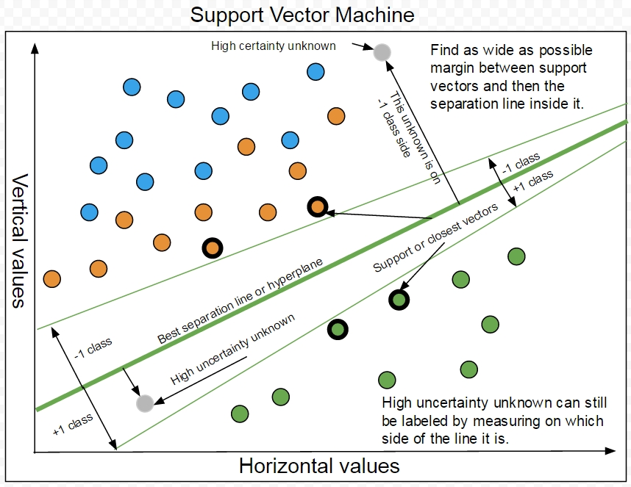
SVM
Find support or closest vectors.
Use them to find best separating line.
Use it to identify class labels of new data.

Slide 9
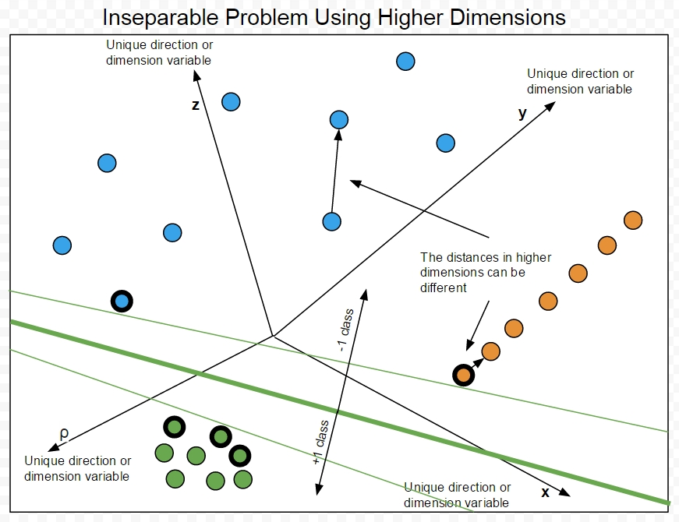
Linearly inseparable and higher dimensions
Plot the vectors to higher dimension.
Meaning measure distances differently.
Use new distances to find support vectors.
Use them to find best separating line.

Slide 10
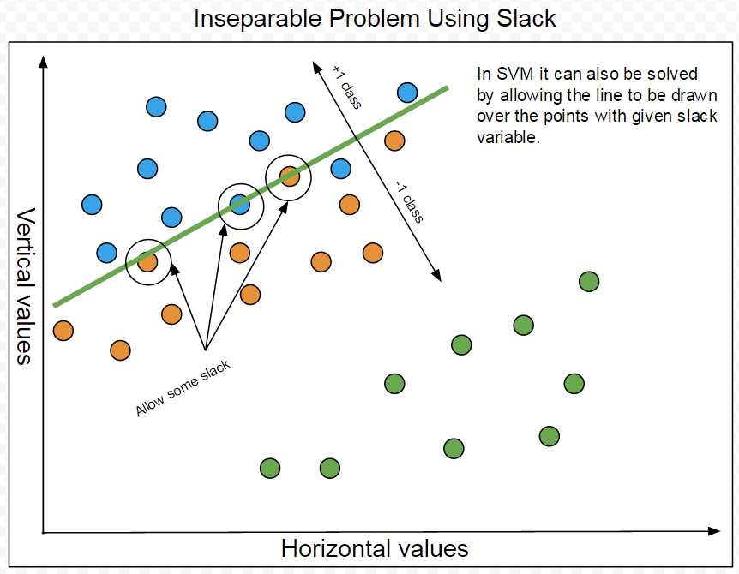
Linearly inseparable and slack variable
Allow the line to cross.
Or introduce value to tune sensitivity.

Slide 11
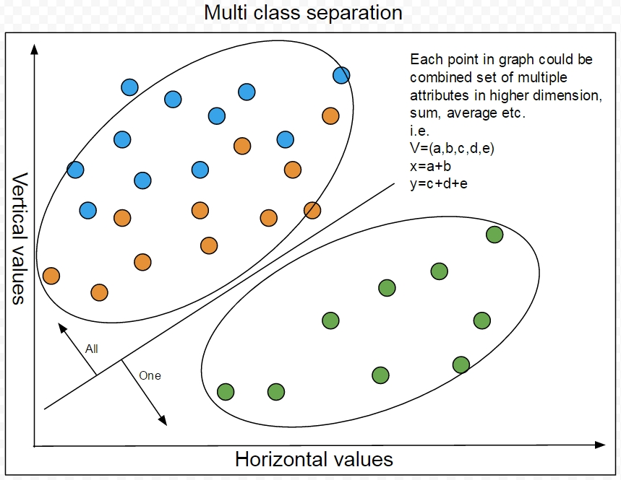
Multi Class solution
Choose the class to represent as “the one”.
The rest represent as “the rest”.
Repeat for all classes.

Slide 12
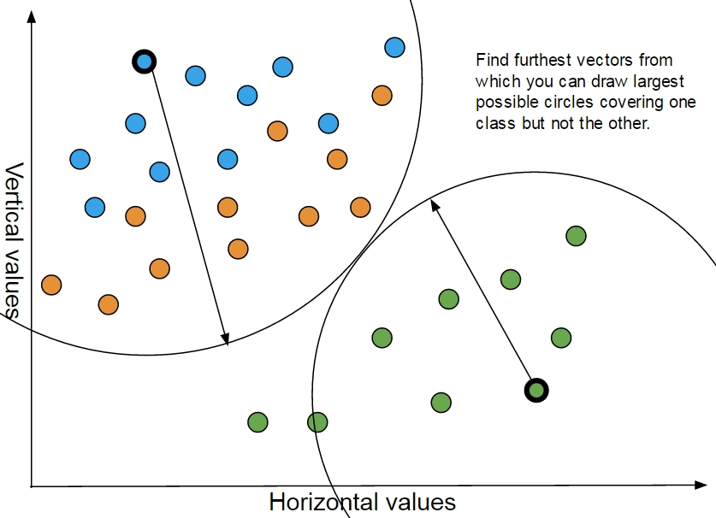
Interpretation
Line could be two very close parallel lines.
Line could be edge of very large circle.
Find vectors that define best circle.
Use it to identify class labels of new data.

Slide 13
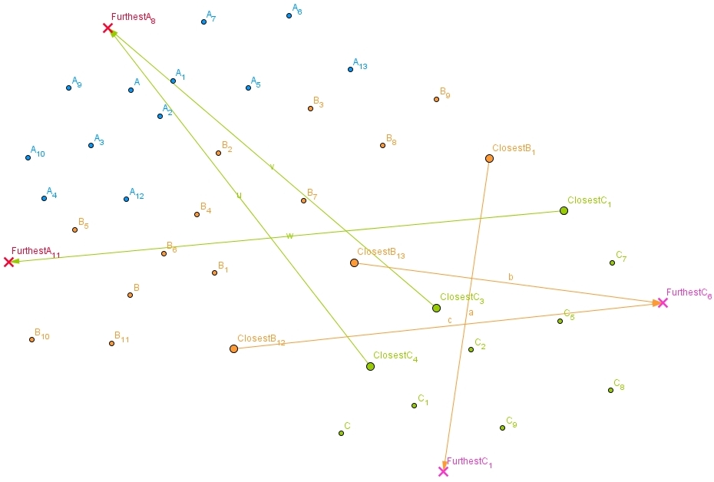
Implementation: Find Points
Find closest vectors.
Use them to find furthest ones.

Slide 14
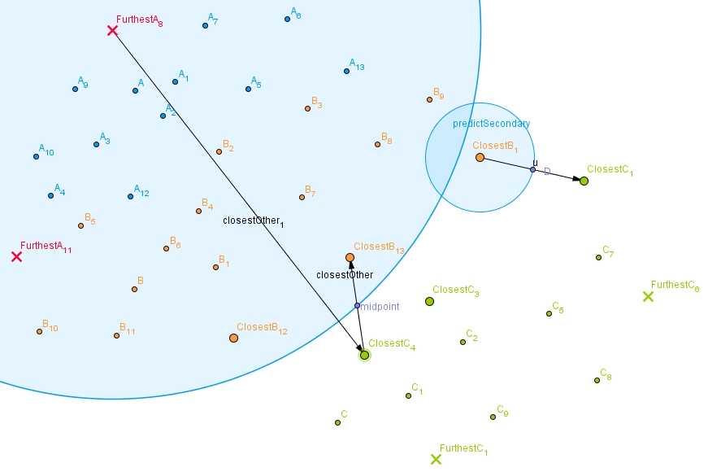
Implementation: Predict Using Circles
Find closest opposite class closest vector.
Repeat.
Find midpoint.
Use radius to check if unknown is in range.
If in range, predict as that class.
Also check each closest radius.
Repeat for each class furthest vector.

Slide 15
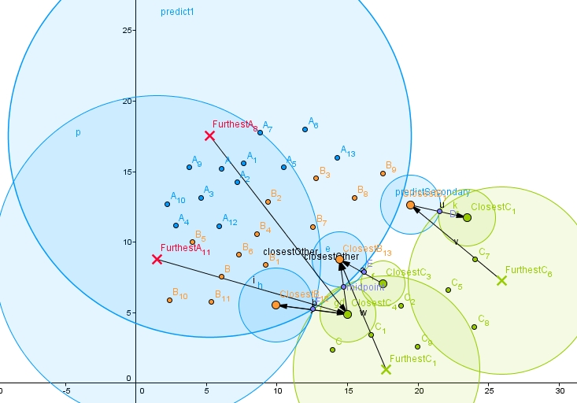
Implementation: Whole Picture
Each class.
Each furthest vector.
Each closest vector.

Slide 16
Results: Table
Included custom made dataset.
Included double check test dataset.
Comparison of LSS, Weka-SVM, R-SVM
Type | Name | Size KB | LSS | R-SVM-RBF | Weka-SVM-RBF
Atomic data | Ligand Protein | 2 | 69.44 | 69.44 | 91.66
Flower | Iris | 5 | 95.33 | 97.33 | 98.66
Bioassay | AID439red_train | 14 | 82.14 | 82.14 | 94.64
Bioassay | AID721red_train | 18 | 100.00 | 82.89 | 94.73
Bioassay | AID644red_train | 38 | 92.72 | 75.15 | 93.33
Bioassay | AID1284red_train | 67 | 97.58 | 84.48 | 93.10
Bioassay | AID1608red_train | 168 | 98.18 | 93.35 | 96.61
Bioassay | AID1608Morered_train | 193 | 98.30 | 93.35 | 96.61
Bioassay | AID362red_train | 724 | 100 | 98.60 | 98.71
Bioassay | AID456red_train | 1627 | 100 | 99.72 | 99.72
Bioassay | AID688red_train | 4428 | 100 | 99.09 | 99.08
Bioassay | AID687red_train | 6025 | 100 | 99.71 | 99.71
Bioassay | AID604AID644_AllRed_train | 7506 | 100 | 99.89 | 99.88
Bioassay | AID604red_train | 10893 | 100 | 99.64 | 99.64
Bioassay | AID746red_train | 10893 | 100 | 99.39 | 99.38
Bioassay | AID373red_train | 11308 | 100 | 99.90 | 99.89
Average |  | 3369.3125 | 95.85563 | 92.13 | 97.21

Slide 17
Results: Graph
Larger dataset- larger precision.
Some datasets similar results.
Custom dataset worst results.

Slide 18
Evaluation
The failure to implement SVM in Java might have led to successful and new way of explaining it.
Implementing something what already exists might be waste of time, but this project focused on using simple examples to educate.
Different views and interpretations about problems can at least be useful by expanding on the ways we look at them and sometimes even help discover the solutions.
Weka-SVM had best results on all datasets.
Surprisingly LSS had better overall results than R-SVM, but that might not be because it works.

Slide 19
Conclusion
Literature review shown that SVM is one of the best techniques.
Even low precision can still help reduce the research space.
Discovery of LSS shown that mathematical ideas could be interpreted differently, while still being used as they are.
The purpose of LSS could become more than educational tool, because it maybe has the potential to become useful machine learning technique.
Educating about biotechnology might not directly solve its problems, but it could help bring more interested potential future inventors.

Slide 20
Future work
Report could be modified to become online guide.
Report could be reduced to lecture size slideshow.
Implementation could improve its speed by using more effective language like C and use hash maps instead of lists.
Further research could be done about how low precision could be used to achieve higher precision.

Slide 21
Acknowledgements
I would like to show my gratitude to my supervisor Mr Ray Ruocco, for having enough patience to help deal with this project implementation uncertainties and problems.
I would also like to thank Dr Aaron Kans, Dr Sin Wee Lee, Dr Paolo Falcarin for teaching programming modules in a way it gave me enough confidence and skill to deal with this project.

Slide 22
References
Ashtawy, H. and Mahapatra, N. (2012). A Comparative Assessment of Ranking Accuracies of Conventional and Machine-Learning-Based Scoring Functions for Protein-Ligand Binding Affinity Prediction. IEEE/ACM Trans. Comput. Biol. and Bioinf. 9(5), pp.1301-1313. Available at: http://ieeexplore.ieee.org/xpl/login.jsp?tp=&arnumber=6171157&url=http%3A%2F%2Fieeexplore.ieee.org%2Fiel5%2F8857%2F4359833%2F06171157.pdf%3Farnumber%3D6171157 [Accessed 5 Oct. 2015].
Noble, S. (2003). Support vector machine applications in computational biology. Washington University Department of Genome Sciences, pp.1-31. Available at: https://www.ibisc.univ-evry.fr/~dalche/cours/noble_support.pdf [Accessed 10 Oct. 2015].
Chinnasamy, A., Sung, W. And Mittal, A. (2005). Protein Structure and Fold Prediction Using Tree-Augmented Naïve Bayesian Classifier. Journal of Bioinformatics and Computational Biology, 03(04), pp.803-819. Available at: http://psb.stanford.edu/psb-online/proceedings/psb04/chinnasamy.pdf [Accessed 20 Oct. 2015].

Slide 23
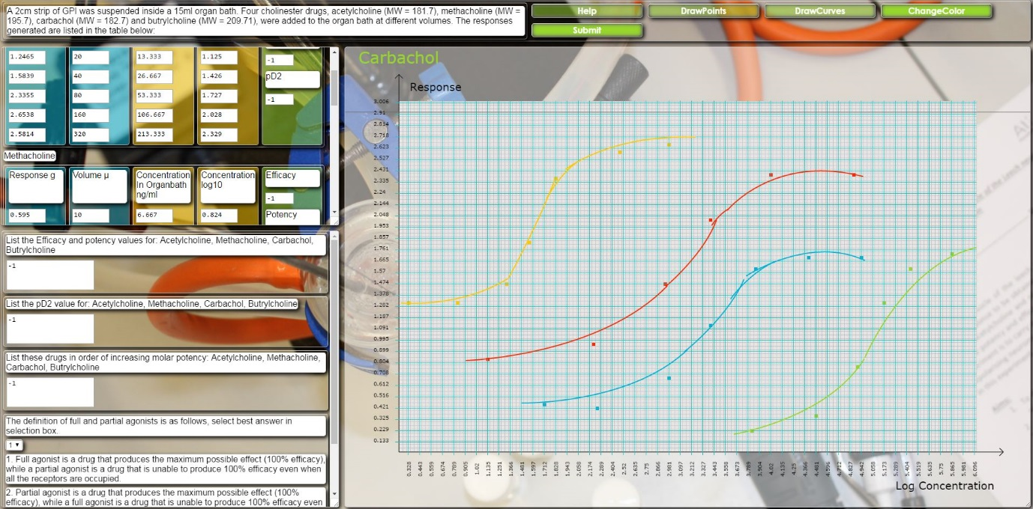
Web Implementation of Bioassay Experiment

